Slide 1
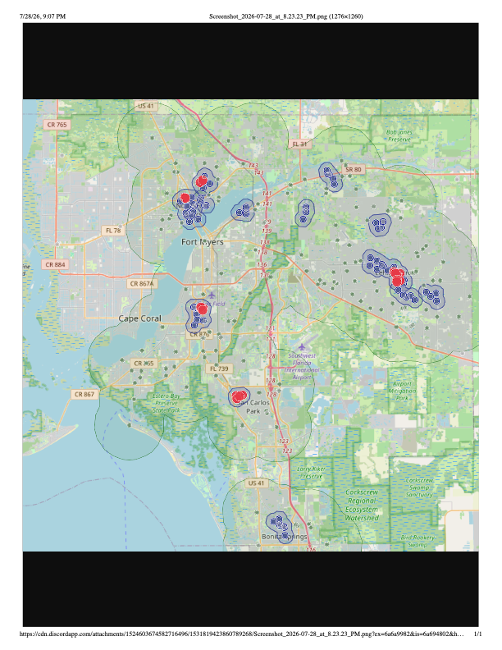
Interactive
Sheriff Activity Map
of Lee County
CDR Presentation
COP 4935 - Fall 2026
Dr. Amoruso
Group A04

Slide 2
Problem Statement
  Sheriff department incident and traffic data is often made publicly available, but when presented as raw records or individual points on a map, the underlying spatial and temporal patterns, which indicate where incidents concentrate and how those patterns shift over time, can be difficult to perceive and interpret. Residents, developers, city planners, and local officials may each want to explore this data for different reasons, but static point maps and raw datasets don't reveal these patterns on their own.

Slide 3
Proposed Solution
  This project addresses this challenge with a web application that integrates interactive map filtering, clustering, and heat mapping, along with animated views of how clustering and density patterns change over time, giving users a more convenient and intuitive way to explore and interpret spatial trends in public safety data. A built-in report generation feature also allows users to summarize their filtered selections for further use.

Slide 4
Proposed Solution (Continued)
MVP Items

Slide 5
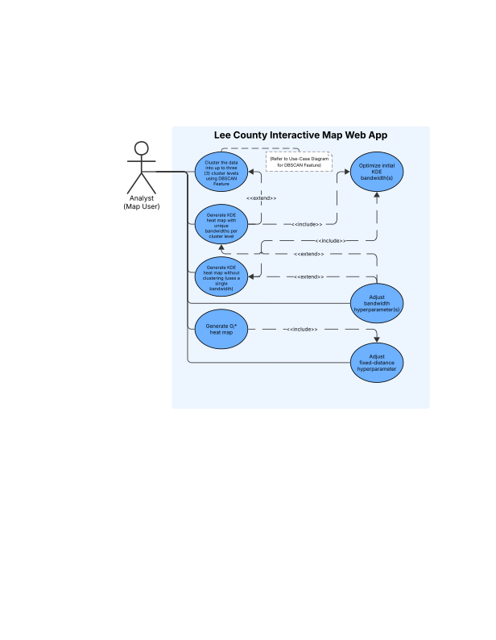
Use-Case Diagram: Heat Map
Heat Map
  MVP: KDE
  Sketch Goal: G_{i}*
Generate Heat Map based on DBSCAN cluster assignments.
Generate Heat Map based on a single grouping.
Adjust parameter for each cluster assignment.
Parameter optimization is automatic

